Slide 1

Module 4: ACL Concepts
Enterprise Networking, Security, and Automation v7.0 (ENSA)

Slide 2
Module Objectives
Module Title: ACL Concepts
Module Objective: Explain how ACLs are used as part of a network security policy.
Topic Title | Topic Objective
Purpose of ACLs | Explain how ACLs filter traffic.
Wildcard Masks in ACLs | Explain how ACLs use wildcard masks.
Guidelines for ACL Creation | Explain how to create ACLs.
Types of IPv4 ACLs | Compare standard and extended IPv4 ACLs.

Slide 3
4.1 Purpose of ACLs

Slide 4
What is an ACL?
Purpose of ACLs
An ACL is a series of IOS commands that are used to filter packets based on information found in the packet header. By default, a router does not have any ACLs configured.
When an ACL is applied to an interface, the router performs the additional task of evaluating all network packets as they pass through the interface to determine if the packet can be forwarded.
An ACL uses a sequential list of permit or deny statements, known as access control entries (ACEs).
Note: ACEs are also commonly called ACL statements.
When network traffic passes through an interface configured with an ACL, the router compares the information within the packet against each ACE, in sequential order, to determine if the packet matches one of the ACEs. This process is called packet filtering.

Slide 5
What is an ACL? (Cont.)
Purpose of ACLs
Several tasks performed by routers require the use of ACLs to identify traffic:
Limit network traffic to increase network performance
Provide traffic flow control
Provide a basic level of security for network access
Filter traffic based on traffic type
Screen hosts to permit or deny access to network services
Provide priority to certain classes of network traffic

Slide 6
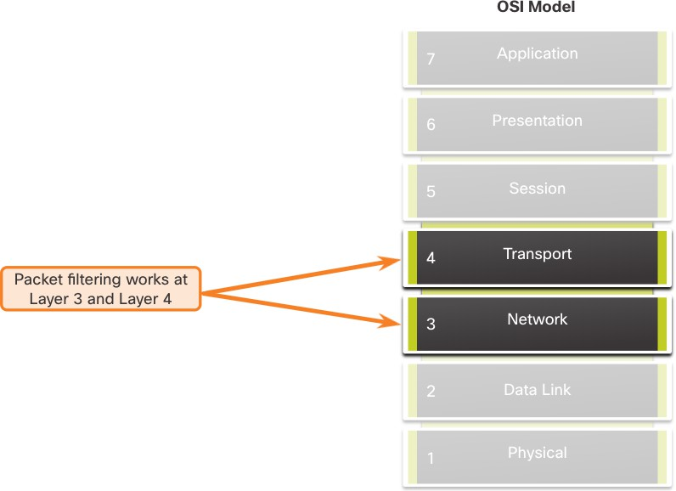
Packet Filtering
Purpose of ACLs
Packet filtering controls access to a network by analyzing the incoming and/or outgoing packets and forwarding them or discarding them based on given criteria.
Packet filtering can occur at Layer 3 or Layer 4.
Cisco routers support two types of ACLs:
Standard ACLs - ACLs only filter at Layer 3
using the source IPv4 address only.
Extended ACLs - ACLs filter at Layer 3 using the source and / or destination IPv4 address. They can also filter at Layer 4 using TCP, UDP ports, and optional protocol type information for finer control.

Slide 7

ACL Operation
Purpose of ACLs
ACLs define the set of rules that give added control for packets that enter inbound interfaces, packets that relay through the router, and packets that exit outbound interfaces of the router.
ACLs can be configured to apply to inbound traffic and outbound traffic.
Note: ACLs do not act on packets that originate from the router itself.
An inbound ACL filters packets before they are routed to the outbound interface. An inbound ACL is efficient because it saves the overhead of routing lookups if the packet is discarded.
An outbound ACL filters packets after being routed, regardless of the inbound interface.

Slide 8
Purpose of ACLs
ACL Operation (Cont.)
When an ACL is applied to an interface, it follows a specific operating procedure. Here are the operational steps used when traffic has entered a router interface with an inbound standard IPv4 ACL configured:
The router extracts the source IPv4 address from the packet header.
The router starts at the top of the ACL and compares the source IPv4 address to each ACE in a sequential order.
When a match is made, the router carries out the instruction, either permitting or denying the
packet, and the remaining ACEs in the ACL, if any, are not analyzed.
If the source IPv4 address does not match any ACEs in the ACL, the packet is discarded because there is an implicit deny ACE automatically applied to all ACLs.
The last ACE statement of an ACL is always an implicit deny that blocks all traffic. It is hidden and not displayed in the configuration.
Note: An ACL must have at least one permit statement otherwise all traffic will be denied due to the implicit deny ACE statement.

Slide 9
Purpose of ACLs
Packet Tracer - ACL Demonstration
In this Packet Tracer, you will complete the following objectives:
Part 1: Verify Local Connectivity and Test Access Control List
Part 2: Remove Access Control List and Repeat Test

Slide 10
4.2 Wildcard Masks in ACLs

Slide 11
Wildcard Mask Overview
Wildcard Masks in ACLs
A wildcard mask is similar to a subnet mask in that it uses the ANDing process to identify which bits in an IPv4 address to match. Unlike a subnet mask, in which binary 1 is equal to a match and binary 0 is not a match, in a wildcard mask, the reverse is true.
An IPv4 ACE uses a 32-bit wildcard mask to determine which bits of the address to
examine for a match.
Wildcard masks use the following rules to match binary 1s and 0s:
Wildcard mask bit 0 - Match the corresponding bit value in the address
Wildcard mask bit 1 - Ignore the corresponding bit value in the address

Slide 12
Wildcard Mask Overview (Cont.)
Wildcard Masks in ACLs
Wildcard Mask | Last Octet (in Binary) | Meaning (0 - match, 1 - ignore)
0.0.0.0 | 00000000 | Match all octets.
0.0.0.63 | 00111111 | Match the first three octets Match the two left most bits of the last octet Ignore the last 6 bits
0.0.0.15 | 00001111 | Match the first three octets Match the four left most bits of the last octet Ignore the last 4 bits of the last octet
0.0.0.248 | 11111100 | Match the first three octets Ignore the six left most bits of the last octet Match the last two bits
0.0.0.255 | 11111111 | Match the first three octet Ignore the last octet

Slide 13
Wildcard Mask Types
Wildcard Masks in ACLs
Wildcard to Match a Host:
Assume ACL 10 needs an ACE that only permits the host with IPv4 address
192.168.1.1. Recall that “0” equals a match and “1” equals ignore. To match a specific
host IPv4 address, a wildcard mask consisting of all zeroes (i.e., 0.0.0.0) is required.
When the ACE is processed, the wildcard mask will permit only the 192.168.1.1 address. The resulting ACE in ACL 10 would be access-list 10 permit 192.168.1.1 0.0.0.0.
 | Decimal | Binary
IPv4 address | 192.168.1.1 | 11000000.10101000.00000001.00000001
Wildcard Mask | 0.0.0.0 | 00000000.00000000.00000000.00000000
Permitted IPv4 Address | 192.168.1.1 | 11000000.10101000.00000001.00000001

Slide 14
Wildcard Mask Types (Cont.)
Wildcard Masks in ACLs
Wildcard Mask to Match an IPv4 Subnet
ACL 10 needs an ACE that permits all hosts in the 192.168.1.0/24 network. The wildcard mask 0.0.0.255 stipulates that the very first three octets must match exactly but the fourth octet does not.
When processed, the wildcard mask 0.0.0.255 permits all hosts in the 192.168.1.0/24 network. The resulting ACE in ACL 10 would be access-list 10 permit 192.168.1.0 0.0.0.255.
 | Decimal | Binary
IPv4 address | 192.168.1.1 | 11000000.10101000.00000001.00000001
Wildcard Mask | 0.0.0.255 | 00000000.00000000.00000000.11111111
Permitted IPv4 Address | 192.168.1.0/24 | 11000000.10101000.00000001.00000000

Slide 15
Wildcard Mask Types (Cont.)
Wildcard Masks in ACLs
Wildcard Mask to Match an IPv4 Address Range
ACL 10 needs an ACE that permits all hosts in the 192.168.16.0/24, 192.168.17.0/24,
…, 192.168.31.0/24 networks.
When processed, the wildcard mask 0.0.15.255 permits all hosts in the 192.168.16.0/24 to 192.168.31.0/24 networks. The resulting ACE in ACL 10 would be access-list 10 permit 192.168.16.0 0.0.15.255.
 | Decimal | Binary
IPv4 address | 192.168.16.0 | 11000000.10101000.00010000.00000000
Wildcard Mask | 0.0.15.255 | 00000000.00000000.00001111.11111111
Permitted IPv4 Address | 192.168.16.0/24 to 192.168.31.0/24 | 11000000.10101000.00010000.00000000 11000000.10101000.00011111.00000000

Slide 16
Wildcard Mask Calculation
Wildcard Masks in ACLs
Calculating wildcard masks can be challenging. One shortcut method is to subtract the subnet mask from 255.255.255.255. Some examples:
Assume you wanted an ACE in ACL 10 to permit access to all users in the 192.168.3.0/24 network. To calculate the wildcard mask, subtract the subnet mask (255.255.255.0) from 255.255.255.255. This produces the wildcard mask 0.0.0.255.
The ACE would be access-list 10 permit 192.168.3.0 0.0.0.255.
Assume you wanted an ACE in ACL 10 to permit network access for the 14 users in the subnet 192.168.3.32/28. Subtract the subnet (i.e., 255.255.255.240) from 255.255.255.255. This produces the wildcard mask 0.0.0.15. The ACE would
be access-list 10 permit 192.168.3.32 0.0.0.15.
Assume you needed an ACE in ACL 10 to permit only networks 192.168.10.0 and 192.168.11.0. These two networks could be summarized as 192.168.10.0/23 which is a subnet mask of 255.255.254.0. Subtract 255.255.254.0 subnet mask from 255.255.255.255. This produces the wildcard mask 0.0.1.255. The ACE would
be access-list 10 permit 192.168.10.0 0.0.1.255.

Slide 17
Wildcard Mask Keywords
Wildcard Masks in ACLs
The Cisco IOS provides two keywords to identify the most common uses of wildcard masking. The two keywords are:
host - This keyword substitutes for the 0.0.0.0 mask. This mask states that all IPv4
address bits must match to filter just one host address.
any - This keyword substitutes for the 255.255.255.255 mask. This mask says to ignore the entire IPv4 address or to accept any addresses.

Slide 18
4.3 Guidelines for ACL Creation

Slide 19
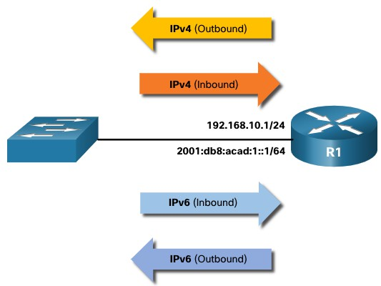
Limited Number of ACLs per Interface
Guidelines for ACL Creation
There is a limit on the number of ACLs that can be applied on a router interface. For example, a dual-stacked (i.e, IPv4 and IPv6) router interface can have up to four ACLs applied, as shown in the figure.
Specifically, a router interface can have:
One outbound IPv4 ACL.
One inbound IPv4 ACL.
One inbound IPv6 ACL.
One outbound IPv6 ACL.
Note: ACLs do not have to be configured in both directions. The number of ACLs and their direction applied to the interface will depend on the security policy of the organization.

Slide 20
Guidelines for ACL Creation
ACL Best Practices
Using ACLs requires attention to detail and great care. Mistakes can be costly in terms of downtime, troubleshooting efforts, and poor network service. Basic planning is required before configuring an ACL.
Guideline | Benefit
Base ACLs on the organizational security policies. | This will ensure you implement organizational security guidelines.
Write out what you want the ACL to do. | This will help you avoid inadvertently creating potential access problems.
Use a text editor to create, edit, and save all of your ACLs. | This will help you create a library of reusable ACLs.
Document the ACLs using the remark command. | This will help you (and others) understand the purpose of an ACE.
Test the ACLs on a development network before implementing them on a production network. | This will help you avoid costly errors.

Slide 21
4.4 Types of IPv4 ACLs

Slide 22
Standard and Extended ACLs
Types of IPv4 ACLs
There are two types of IPv4 ACLs:
Standard ACLs - These permit or deny packets based only on the source IPv4 address.
Extended ACLs - These permit or deny packets based on the source IPv4 address and destination IPv4 address, protocol type, source and destination TCP or UDP ports and more.

Slide 23
Types of IPv4 ACLs
Numbered and Named ACLs
Numbered ACLs
ACLs numbered 1-99, or 1300-1999 are standard ACLs, while ACLs numbered 100- 199, or 2000-2699 are extended ACLs.
R1(config)# access-list ?
<1-99> IP standard access list
<100-199> IP extended access list
<1100-1199> Extended 48-bit MAC address access list
<1300-1999> IP standard access list (expanded range)
<200-299> Protocol type-code access list
<2000-2699> IP extended access list (expanded range)
<700-799> 48-bit MAC address access list
rate-limit Simple rate-limit specific access list template Enable IP template acls
Router(config)# access-list

Slide 24
Numbered and Named ACLs (Cont.)
Types of IPv4 ACLs
Named ACLs
Named ACLs are the preferred method to use when configuring ACLs. Specifically, standard and extended ACLs can be named to provide information about the purpose of the ACL. For example, naming an extended ACL FTP-FILTER is far better than having a numbered ACL 100.
The ip access-list global configuration command is used to create a named ACL, as shown in the following example.
R1(config)# ip access-list extended FTP-FILTER
R1(config-ext-nacl)# permit tcp 192.168.10.0 0.0.0.255 any eq ftp R1(config-ext-nacl)# permit tcp 192.168.10.0 0.0.0.255 any eq ftp-data R1(config-ext-nacl)#

Slide 25
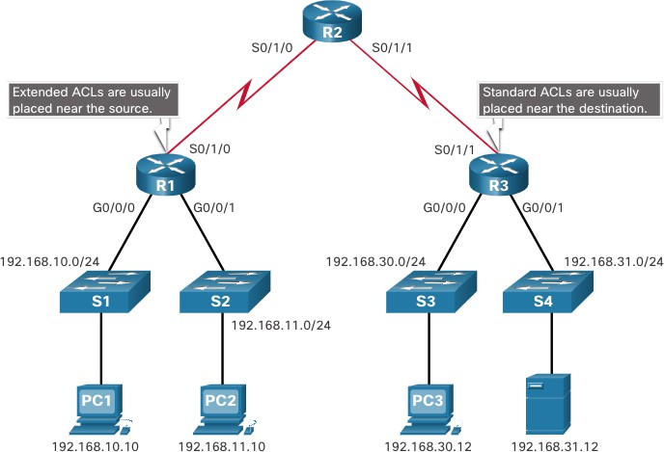
Where to Place ACLs
Types of IPv4 ACLs
Every ACL should be placed where it has the greatest impact on efficiency.
Extended ACLs should be located as close as possible to the source of the traffic to be filtered.
Standard ACLs should be located as close to the destination as possible.

Slide 26
Where to Place ACLs (Cont.)
Types of IPv4 ACLs
Factors Influencing ACL Placement | Explanation
The extent of organizational control | Placement of the ACL can depend on whether or not the organization has control of both the source and destination networks.
Bandwidth of the networks involved | It may be desirable to filter unwanted traffic at the source to prevent transmission of bandwidth-consuming traffic.
Ease of configuration | It may be easier to implement an ACL at the destination, but traffic will use bandwidth unnecessarily. An extended ACL could be used on each router where the traffic originated. This would save bandwidth by filtering the traffic at the source, but it would require creating extended ACLs on multiple routers.

Slide 27
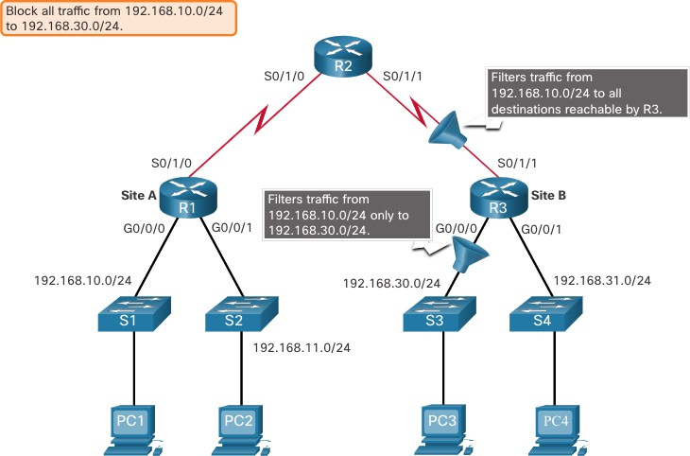
Standard ACL Placement Example
Types of IPv4 ACLs
In the figure, the administrator wants to prevent traffic originating in the 192.168.10.0/24 network from reaching the 192.168.30.0/24 network.
Following the basic placement guidelines, the administrator would place a standard ACL on router R3.

Slide 28
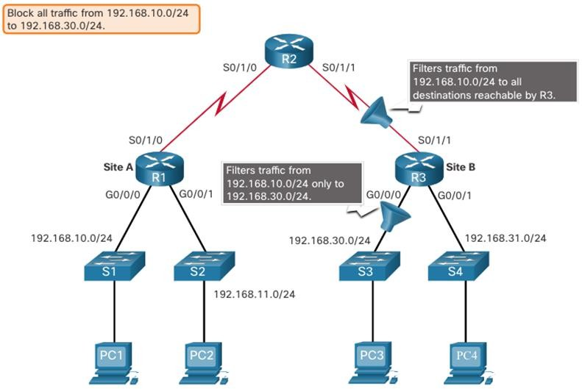
Types of IPv4 ACLs
Standard ACL Placement Example (Cont.)
There are two possible interfaces on R3 to apply the standard ACL:
R3 S0/1/1 interface (inbound) - The standard ACL can be applied inbound on the R3 S0/1/1 interface to deny traffic from .10 network. However, it would also filter .10 traffic to the 192.168.31.0/24 (.31 in this example) network. Therefore, the standard ACL should not be applied to this interface.
R3 G0/0 interface (outbound) - The standard ACL can be applied outbound on the R3 G0/0/0 interface. This will not affect other networks that are reachable by R3. Packets from .10 network will still be able to reach the .31 network. This is the best interface to place the standard ACL to meet the traffic requirements.

Slide 29
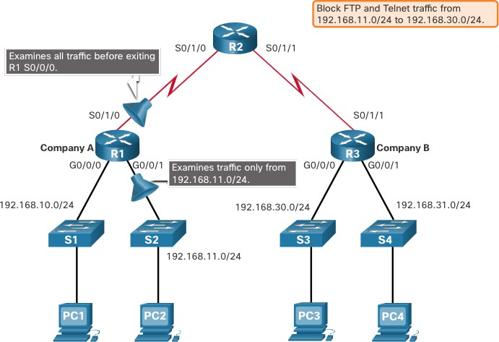
Extended ACL Placement Example
Types of IPv4 ACLs
Extended ACLs should be located as close to the source as possible.
However, the organization can only place ACLs on devices that they control. Therefore, the extended ACL placement must be determined in the context of where organizational control extends.
In the figure, for example, Company A wants to deny Telnet and FTP traffic to Company B’s 192.168.30.0/24 network from their 192.168.11.0/24 network, while permitting all other traffic.

Slide 30
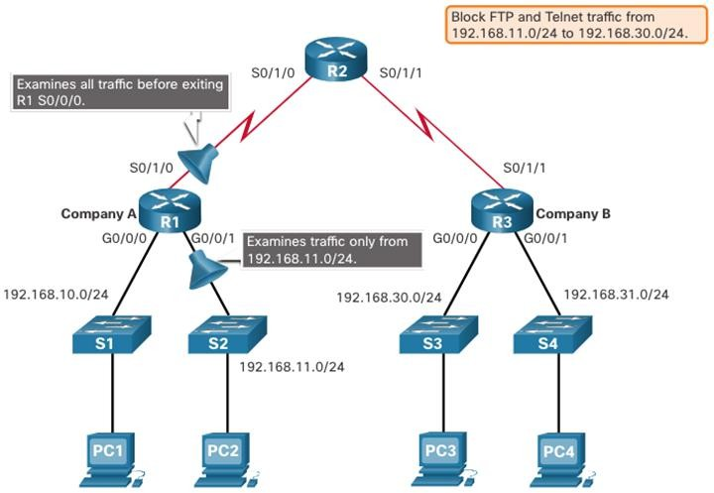
Types of IPv4 ACLs
Extended ACL Placement Example (Cont.)
An extended ACL on R3 would accomplish the task, but the administrator does not control R3. In addition, this solution allows unwanted traffic to cross the entire network, only to be blocked at the destination.
The solution is to place an extended ACL on R1 that specifies both source and destination addresses.
There are two possible interfaces on R1 to apply the extended ACL:
R1 S0/1/0 interface (outbound) - The extended ACL can be applied outbound on the S0/1/0 interface. This solution will process all packets leaving R1 including packets from 192.168.10.0/24.
R1 G0/0/1 interface (inbound) - The extended ACL can be applied inbound on the G0/0/1 and only packets from the 192.168.11.0/24 network are subject to ACL processing on R1. Because the filter is to be limited to only those packets leaving the 192.168.11.0/24 network, applying the extended ACL to G0/1 is the best solution.

Slide 31
4.5 Module Practice and Quiz

Slide 32
What Did I Learn In This Module?
Module Practice and Quiz
An ACL is a series of IOS commands that are used to filter packets based on information found in the packet header.
A router does not have any ACLs configured by default.
When an ACL is applied to an interface, the router performs the additional task of evaluating all network packets as they pass through the interface to determine if the packet can be forwarded.
An ACL uses a sequential list of permit or deny statements, known as ACEs.
Cisco routers support two types of ACLs: standard ACLs and extended ACLs.
An inbound ACL filters packets before they are routed to the outbound interface. If the packet is permitted
by the ACL, it is then processed for routing.
An outbound ACL filters packets after being routed, regardless of the inbound interface.
An IPv4 ACE uses a 32-bit wildcard mask to determine which bits of the address to examine for a match.
A wildcard mask is similar to a subnet mask in that it uses the ANDing process to identify which bits in an
IPv4 address to match. However, they differ in the way they match binary 1s and 0s. Wildcard mask bit 0 matches the corresponding bit value in the address. Wildcard mask bit 1 ignores the corresponding bit value in the address.

Slide 33
What Did I Learn In This Module? (Cont.)
Module Practice and Quiz
A shortcut to calculating a wildcard mask is to subtract the subnet mask from 255.255.255.255.
Working with decimal representations of binary wildcard mask bits can be simplified by using the Cisco IOS
keywords host and any to identify the most common uses of wildcard masking.
There is a limit on the number of ACLs that can be applied on a router interface.
ACLs do not have to be configured in both directions. The number of ACLs and their direction applied to the interface will depend on the security policy of the organization.
Standard ACLs permit or deny packets based only on the source IPv4 address.
Extended ACLs permit or deny packets based on the source IPv4 address and destination IPv4 address,
protocol type, source and destination TCP or UDP ports and more.
ACLs numbered 1-99, or 1300-1999, are standard ACLs. ACLs numbered 100-199, or 2000-2699, are extended ACLs.
Named ACLs is the preferred method to use when configuring ACLs.
Specifically, standard and extended ACLs can be named to provide information about the purpose of the
ACL.
Every ACL should be placed where it has the greatest impact on efficiency.

Slide 34
What Did I Learn In This Module? (Cont.)
Module Practice and Quiz
Extended ACLs should be located as close as possible to the source of the traffic to be filtered. This way, undesirable traffic is denied close to the source network without crossing the network infrastructure.
Standard ACLs should be located as close to the destination as possible. If a standard ACL was placed at the source of the traffic, the "permit" or "deny" will occur based on the given source address no matter where the traffic is destined.
Placement of the ACL may depend on the extent of organizational control, bandwidth of the networks, and ease of configuration.

Slide 35


